Slide 1


Minor Project
Title: Supplychain Path Optimizer
Mentored By:
Mr. Aishik Biswas
Asst. Professor
Cloud Cluster(CSO)
SOCs
Presented by:
Ayush Agarwal [500101834]

Slide 2
Content
Introduction
Literature Review
Objectives
Methodology
Data / Data Structures and Algorithm
SWOT Analysis
References
Conclusion

Slide 3
Abstract:
SupplyChain Path Optimizer is a supply chain management system designed to help small and medium-sized businesses improve their supply chain operations. The system focuses on four key areas: inventory management, order processing, supplier selection, and delivery route optimization. By using powerful algorithms such as Dijkstra’s for shortest path calculation and the Traveling Salesman Problem (TSP) for route planning, the system ensures efficient and cost-effective supply chain management.
Introduction:
The "SupplyChain Path Optimizer" project leverages predictive analytics to enhance supply chain efficiency. By analyzing transportation routes, inventory levels, and demand patterns, this tool identifies the most cost-effective and timely pathways for goods, improving resource utilization and operational performance.
Motivation:
The project was driven by the need to tackle prevalent inefficiencies in supply chain management, such as suboptimal routing, high transportation costs, and delayed deliveries. By optimizing supply chain paths, the project aims to enhance operational efficiency, reduce costs, and improve overall performance, addressing key challenges faced by organizations in managing complex supply networks.
Problem Statement:
Businesses face challenges in effectively managing supply chains, including tracking inventory, processing orders, selecting suppliers, and finding optimal delivery routes. This project aims to develop a system that addresses these issues by optimizing each component of the supply chain.

Slide 4
Literature Review
Existing systems like SAP SCM and Oracle SCM focus on large-scale enterprise solutions with complex features. These systems often require significant resources to implement and maintain.
Optimization Algorithms in SCM: Studies highlight the use of Dijkstra's algorithm for shortest path problems (Rao et al., 2015) and TSP algorithms for route optimization (Johnson & McGeoch, 1997). These algorithms have been successfully applied to reduce costs and improve efficiency in logistics.
Order Processing Techniques: Research by Zhang et al. (2018) discusses the effectiveness of queue-based order processing systems in e-commerce platforms, emphasizing speed and accuracy in fulfilling customer orders.
Cite Related Work:
SAP SCM (2014): Comprehensive solution for supply chain management in large enterprises.
Rao et al. (2015): Application of Dijkstra's algorithm in logistics.
Johnson & McGeoch (1997): Analysis of TSP algorithms for route optimization.
Zhang et al. (2018): Queue-based order processing in e-commerce.

Slide 5
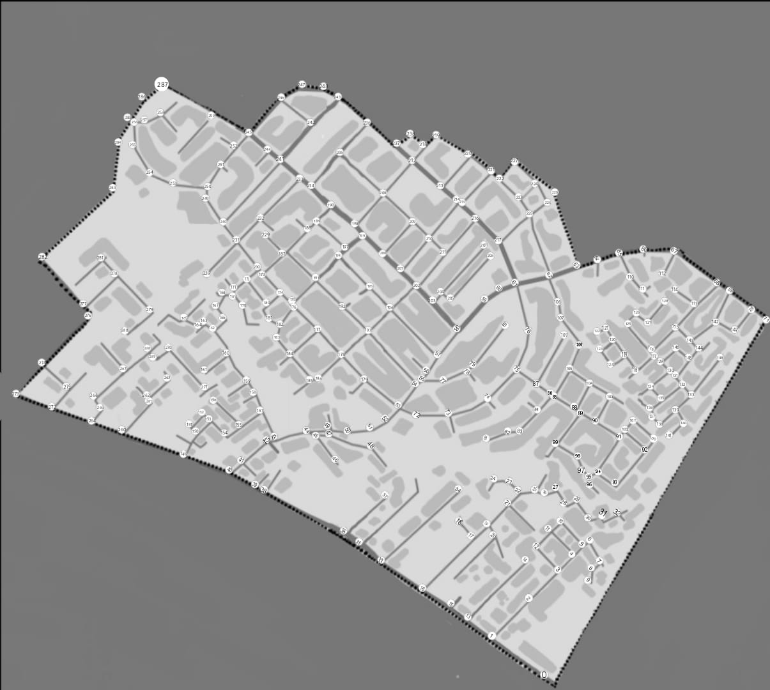

Slide 6
Objective
The primary objective of the Supply Chain Path Optimizer project is to create a comprehensive and intuitive supply chain management solution designed to streamline key processes. This system will focus on:
Optimizing Inventory Management: Efficiently track and manage inventory levels to ensure optimal stock availability and reduce excess inventory costs.
Enhancing Order Processing: Simplify and accelerate order handling to improve accuracy and speed of fulfillment.
Selecting Ideal Suppliers: Assist businesses in identifying and choosing the most suitable suppliers to enhance supply chain reliability and cost-effectiveness.
Planning Optimal Delivery Routes: Utilize advanced algorithms to determine the most efficient delivery routes, reducing transportation costs and improving delivery times.

Slide 7
1) Requirement Analysis
Identify key functionalities, including inventory management, order processing, supplier selection, and delivery route optimization.
2) System Architecture Design
Design the system architecture, defining the interaction between different components (inventory, orders, suppliers, routes).
3) Module Development
Develop individual modules for inventory management, order processing, supplier selection, and route optimization.
Methodology
6) Deployment
Deploy the system to the production environment.
5) Quality Assurance
Conduct thorough testing, including unit tests, integration tests, and user acceptance tests (UAT).
4) System Integration
Seamlessly integrate the developed modules into a unified system.

Slide 8
Data / Data Structures and Algorithms
Technical Concepts (Algorithms) Used:
Dijkstra's Algorithm: Finds the shortest path between nodes in a graph, ensuring minimal travel cost or time.
Traveling Salesman Problem (TSP) Algorithm: Determines the shortest possible route that visits each city exactly once and returns to the origin, optimizing overall travel distance.
Area of Application:
Logistics: Optimizes transportation routes and fleet operations to reduce costs and improve efficiency.
Retail: Improves stock management and supply orders to minimize stockouts and overstock.
Manufacturing: Coordinates raw material supply and production schedules to boost efficiency and lower costs.
E-commerce: Enhances order fulfillment and inventory management for timely deliveries and customer satisfaction.
Dataset and Input Format:
Inventory Data: Includes product names and quantities, stored in a structured format like arrays or hash maps.
Order Data: Contains order IDs, product details, and quantities, managed using queues. Supplier
Network: Represented as a graph with nodes for suppliers and edges for distances or costs.
Delivery Routes: Defined as a matrix of distances between locations, used in the TSP algorithm.

Slide 9
SWOT Analysis
Strengths:
Efficient algorithms for optimization (Dijkstra's, TSP).
Simplified interface suitable for small to medium businesses.
Cost-effective solution for smaller operations.
Weaknesses:
Basic UI might not meet the needs of larger companies.
Initial setup and integration require careful planning.
Potential limitations in handling complex, large-scale supply chains.
Opportunities:
Expansion into mobile and cloud-based solutions.
Customization options for specific industries.
Potential for AI integration to enhance decision-making.
Threats:
Rapid changes in technology may require frequent updates.
Data security concerns with supplier and customer information.
Potential for market saturation as more competitors enter the space.

Slide 10
Conclusion
Optimal Performance and Customization: The system integrates Dijkstra's algorithm for efficient route optimization and TSP for enhanced logistics management. It can be customized for various industries like retail, manufacturing, or healthcare, increasing its relevance and effectiveness.
User-Friendly Design and Expansion Opportunities: Designed for simplicity and ease of use, the system promotes high adoption rates. Future growth can include mobile and cloud-based versions for remote management and real-time decision-making.
Data Security: robust data protection measures ensure the security of sensitive information and regulatory compliance.

Slide 11
References
Optimizing supply chain management: strategic business models and solutionsusing SAP S/4HANAOluwatosin Abdul-Azeez 1, *, Alexsandra Ogadimma Ihechere 2 and Courage Idemudia 3
Graph Theory: Application of graphs to the shortest path problem with Dijkstra's algorithmAdinda PUTRI Sahrita.
Johnson, David S. and McGeoch, Lyle A.. "8. The traveling salesman problem: a case study". Local Search in Combinatorial Optimization, edited by Emile Aarts and Jan Karel Lenstra, Princeton: Princeton University Press, 2003, pp. 215-310.
Order-Picking Efficiency in E-Commerce Warehouses: A Literature ReviewDecember 2022Yi LiRuining ZhangDandan Jiang

Slide 12
Thank You

